Slide 1



WILEY
IFRS EDITION
Prepared by
Coby Harmon
University of California, Santa Barbara
Westmont College

Slide 2
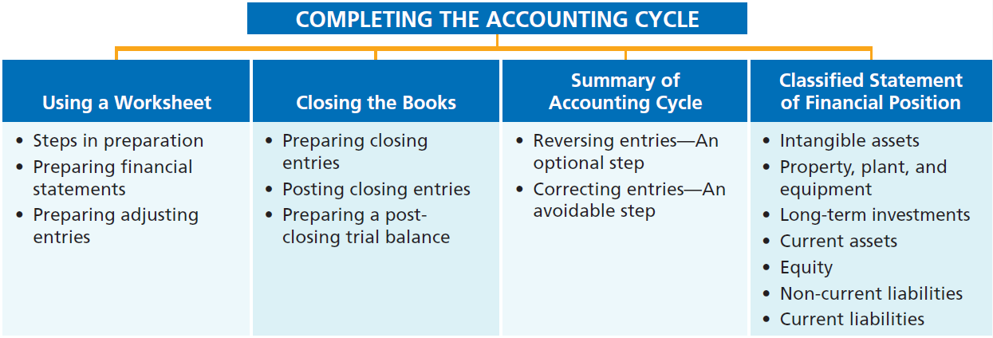
PREVIEW OF CHAPTER 4

Slide 3
CHAPTER
4
Completing the Accounting Cycle
LEARNING OBJECTIVES
After studying this chapter, you should be able to:
Prepare a worksheet.
Explain the process of closing the books.
Describe the content and purpose of a post-closing trial balance.
State the required steps in the accounting cycle.
Explain the approaches to preparing correcting entries.
Identify the sections of a classified statement of financial position.

Slide 4
Using a Worksheet
Learning Objective 1 Prepare a worksheet.
Worksheet
Multiple-column form used in preparing
financial statements.
Not a permanent accounting record.
May be a computerized worksheet using an electronic spreadsheet program such as Excel.
Prepared using a five step process.
Use of worksheet is optional.
LO 1

Slide 5
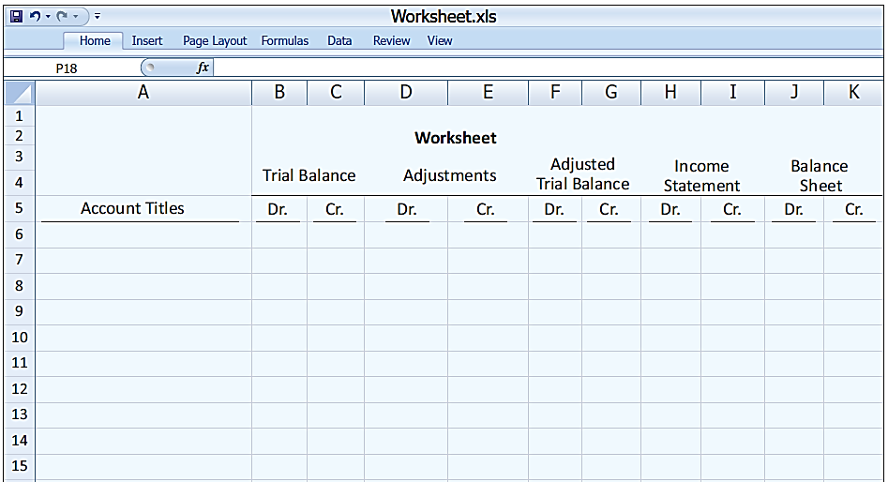
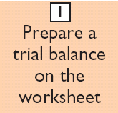
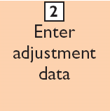
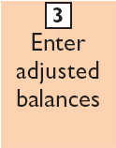
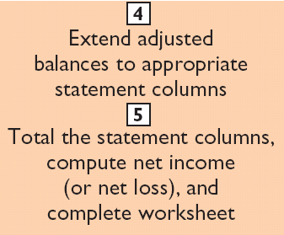
Steps in Preparing a Worksheet
Illustration 4-1
Form and procedure
for a worksheet

Slide 6
Steps in Preparing a Worksheet
Illustration 4-2
1. PREPARE A TRIAL BALANCE ON THE WORKSHEET
Trial balance amounts come directly from ledger accounts.
Include all accounts with balances.
LO 1

Slide 7
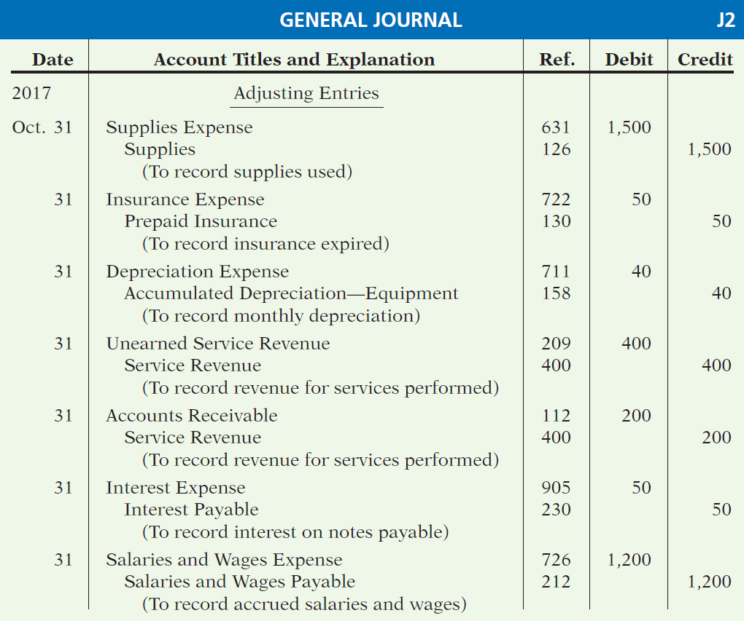
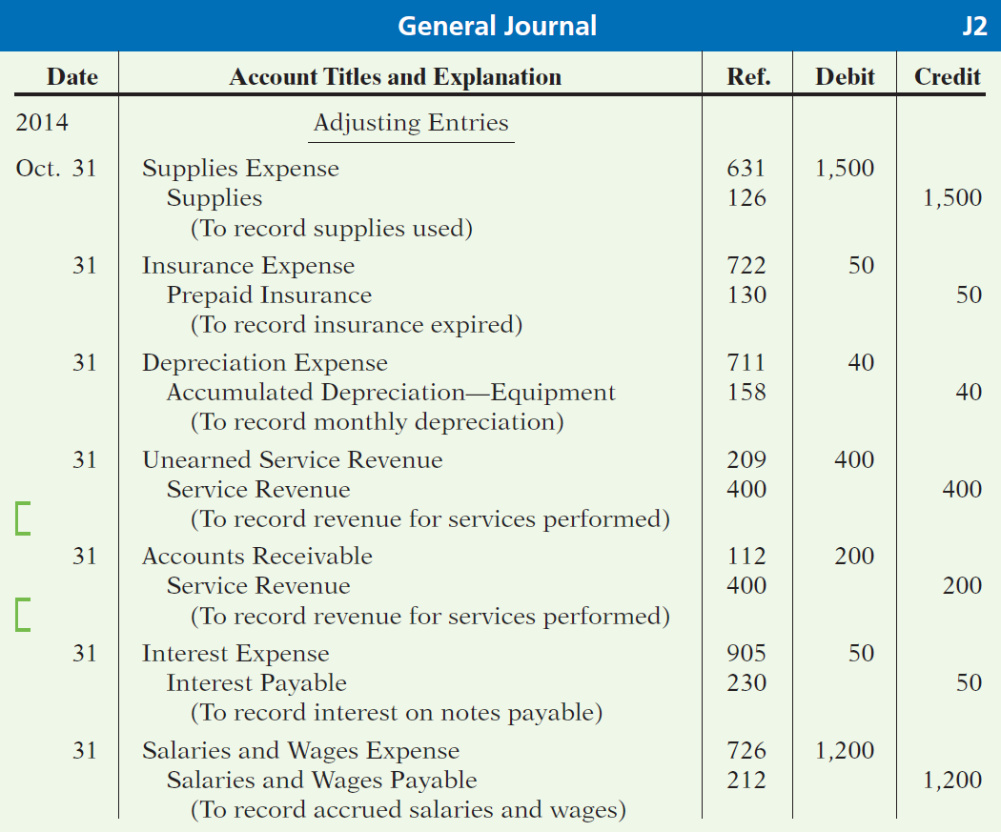
Steps in Preparing a Worksheet
Illustration 3-23
General journal showing adjusting entries
Adjusting Journal Entries
(Chapter 3)

Slide 8
Steps in Preparing a Worksheet
Illustration 4-2
2. ENTER THE ADJUSTMENTS IN THE ADJUSTMENTS COLUMNS
(a)
(b)
Adjustments Key:
(a) Supplies Used.
(b) Insurance Expired.
(c) Depreciation Expensed.
(d) Service Revenue Recognized.
(e) Service Revenue Accrued.
(f) Interest Accrued.
(g) Salaries Accrued.
(d)
(d)
(g)
(e)
(a)
(b)
(c)
(c)
(e)
Enter adjustment amounts, total adjustments columns,
and check for equality.
(f)
(f)
(g)
Add additional accounts as needed.
LO 1

Slide 9
Steps in Preparing a Worksheet
Illustration 4-2
3. COMPLETE THE ADJUSTED TRIAL BALANCE COLUMNS
(a)
(b)
(d)
(d)
(g)
(e)
(a)
(b)
(c)
(c)
(e)
(f)
(f)
(g)
Total the adjusted trial balance columns and check for equality.
LO 1

Slide 10
Steps in Preparing a Worksheet
Illustration 4-2
4. EXTEND AMOUNTS TO FINANCIAL STATEMENT COLUMNS
(a)
(b)
(d)
(d)
(g)
(e)
(a)
(b)
(c)
(c)
(e)
(f)
(f)
(g)
Extend all revenue and expense account balances to the income statement columns.
LO 1

Slide 11
Steps in Preparing a Worksheet
Illustration 4-2
5. TOTAL COLUMNS, COMPUTE NET INCOME (LOSS)
(a)
(b)
(d)
(d)
(g)
(e)
(a)
(b)
(c)
(c)
(e)
(f)
(f)
(g)
Compute Net Income or Net Loss.
LO 1

Slide 12
Steps in Preparing a Worksheet
Question
Which of the following statements is incorrect concerning the worksheet?
The worksheet is essentially a working tool of the accountant.
The worksheet is distributed to management and other interested parties.
The worksheet cannot be used as a basis for posting to ledger accounts.
Financial statements can be prepared directly from the worksheet before journalizing and posting the adjusting entries.
LO 1

Slide 13
Preparing Financial Statements from a Worksheet
Income statement is prepared from the income statement columns.
Statement of financial position and retained earnings statement are prepared from the statement of financial position columns.
Companies can prepare financial statements before they journalize and post adjusting entries.
LO 1

Slide 14
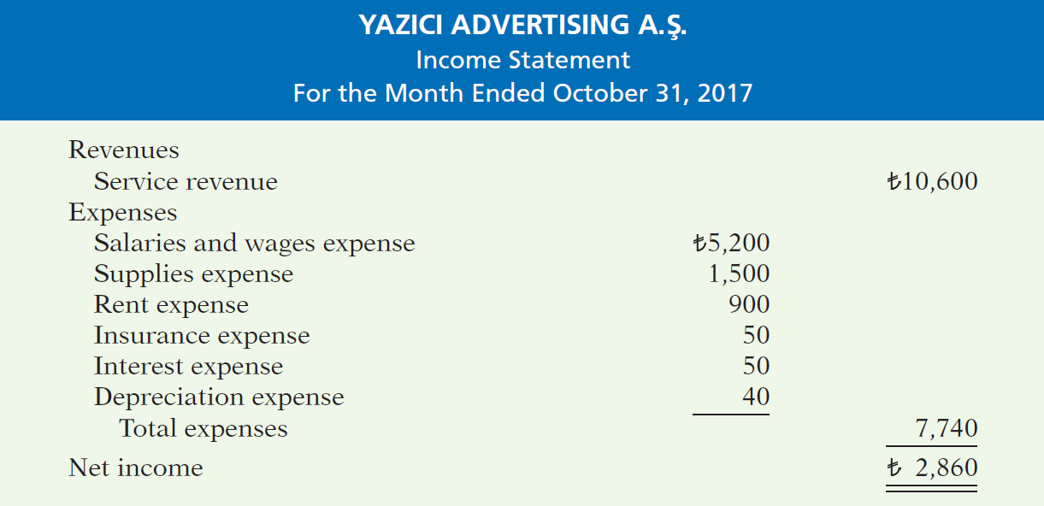
Preparing Statements from a Worksheet
Illustration 4-3
Financial statements from a worksheet
LO 1

Slide 15
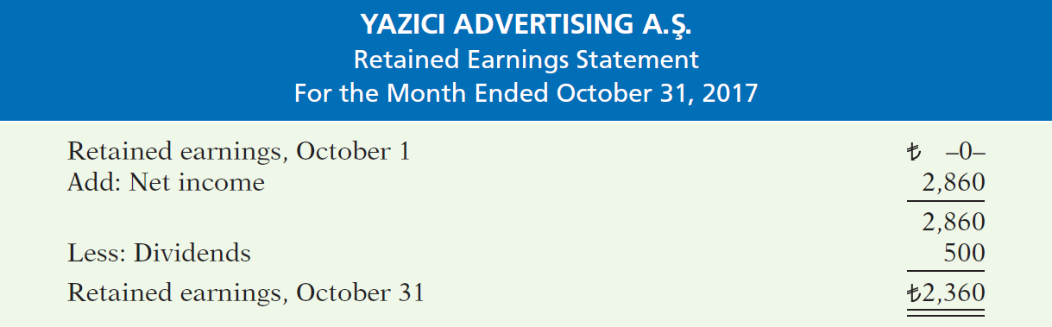
Preparing Statements from a Worksheet
Illustration 4-3
Financial statements from a worksheet
LO 1

Slide 16
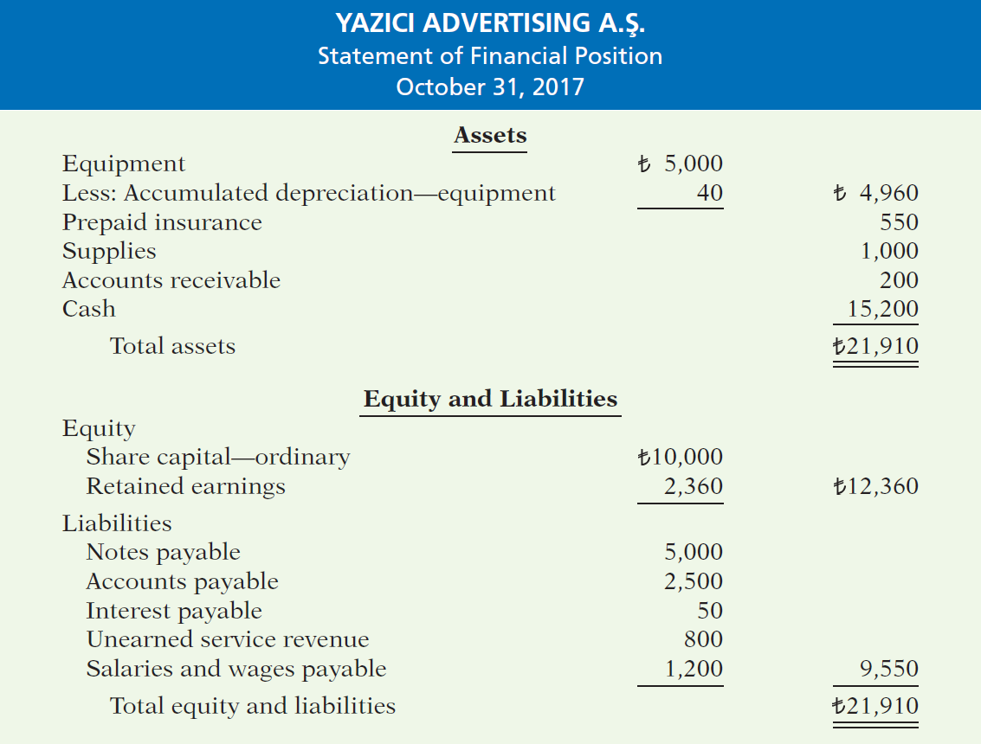
Illustration 4-3
Financial statements from a worksheet
LO 1

Slide 17
Preparing Adjusting Entries from a Worksheet
Adjusting entries are prepared from the adjustments columns of the worksheet.
Journalizing and posting of adjusting entries follows the preparation of financial statements when a worksheet is used.
LO 1

Slide 18
>
DO IT!
Susan Elbe is preparing a worksheet. Explain to Susan how she should extend the following adjusted trial balance accounts to the financial statement columns of the worksheet.
Cash
Statement of financial position (debit column)
Accumulated Depreciation
Statement of financial position (credit column)
Accounts Payable
Dividends
Income statement
(debit column)
Service Revenue
Salaries and Wages Expense
Income statement
(credit column)
LO 1

Slide 19
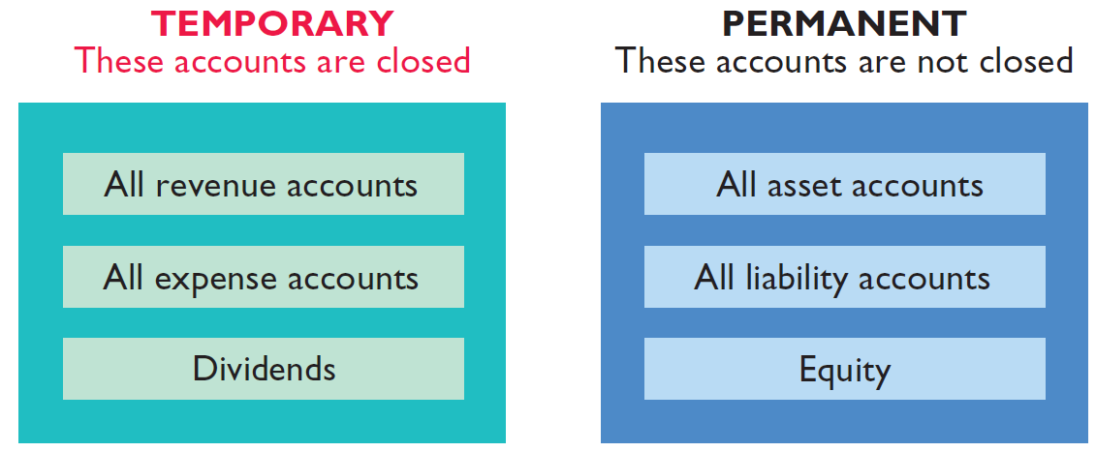
Closing the Books
Learning Objective 2
Explain the process of closing the books.
At the end of the accounting period, the company makes the accounts ready for the next period.
Illustration 4-4
Temporary versus permanent accounts
LO 2

Slide 20
Preparing Closing Entries
Closing entries formally recognize in the ledger the transfer of
net income (or net loss) and
Dividends
to Retained Earnings.
Companies generally journalize and post closing entries only at the end of the annual accounting period.
Closing entries produce a zero balance in each temporary account.
LO 2

Slide 21
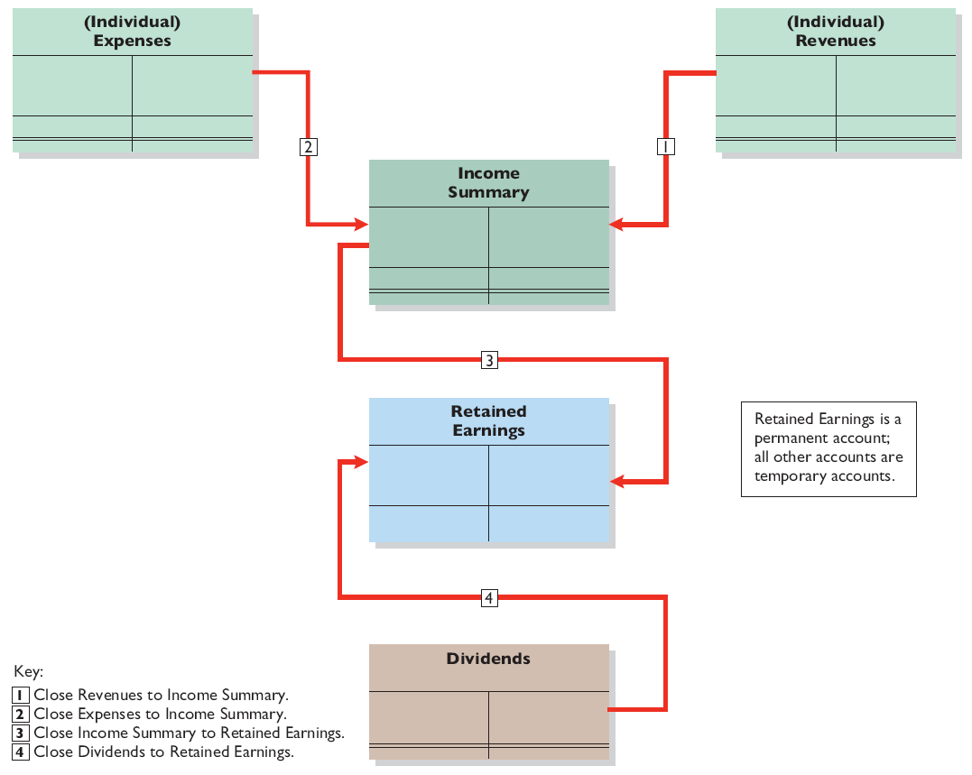
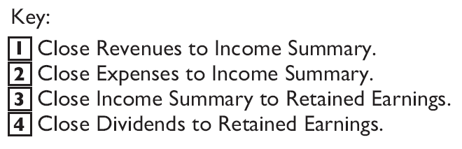
Illustration 4-5
Diagram of closing process—corporation
• HELPFUL HINT
The Dividends account is
closed directly to Retained
Earnings and not to
Income Summary because
dividends are not an
expense.
Retained earnings is a permanent account. All other accounts are temporary accounts.
LO 2

Slide 22
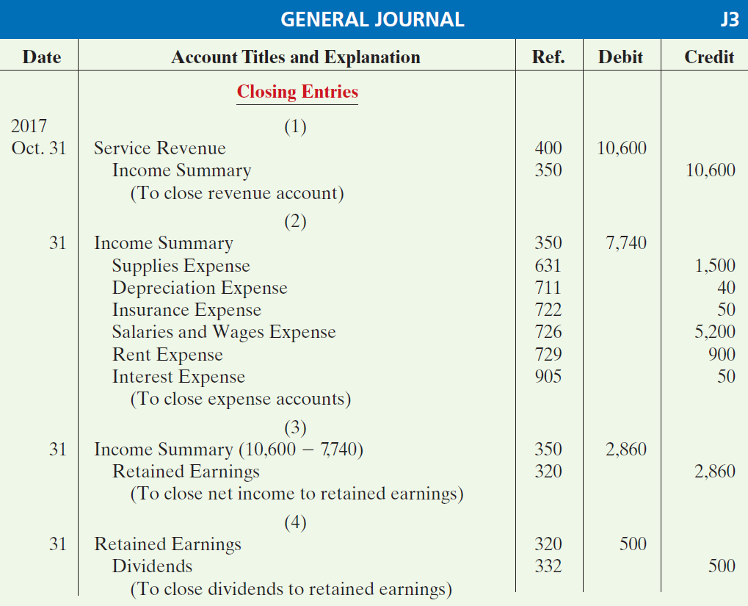
Illustration 4-6
Closing entries journalized
LO 2

Slide 23
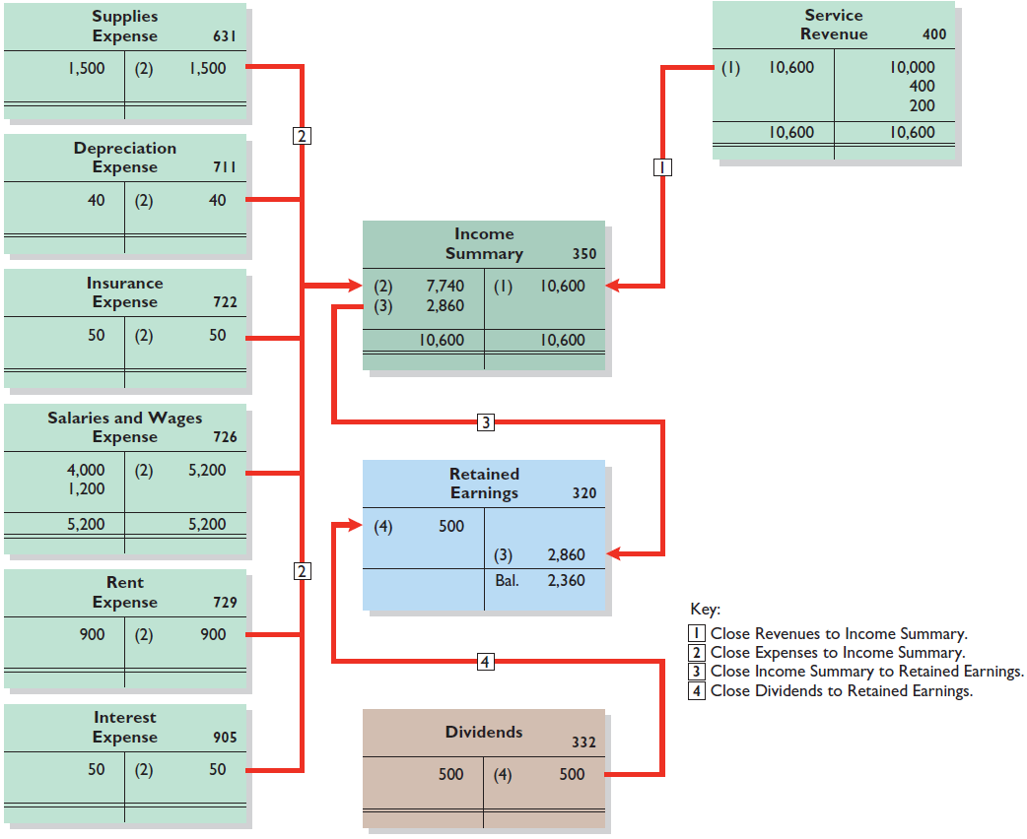
Posting Closing Entries
Illustration 4-7
Posting of closing entries
LO 2

Slide 24
ACCOUNTING ACROSS THE ORGANIZATION
Performing the Virtual Close
Technology has dramatically shortened the closing process. Recent surveys have reported that the average company now takes only six to seven days to close, rather than 20 days. But a few companies do much better. Some companies can perform a “virtual close”—closing within 24 hours on any day in the quarter. One company even improved its closing time by 85%. Not very long ago, it took 14 to 16 days. Managers at these companies emphasize that this increased speed has not reduced the accuracy and completeness of the data. This is not just showing off. Knowing exactly where you are financially all of the time allows the company to respond faster than competitors. It also means that the hundreds of people who used to spend 10 to 20 days a quarter tracking transactions can now be more usefully employed on things such as mining data for business intelligence to find new business opportunities.
Source: “Reporting Practices: Few Do It All,” Financial Executive (November 2003), p. 11.
LO 2

Slide 25
>
DO IT!
The worksheet for Hancock Company shows the following in the financial statement columns:
Dividends €15,000
Common stock €42,000
Net income €18,000
Prepare the closing entries at December 31 that affect equity.
Income Summary 18,000
Retained Earnings 18,000
Retained Earnings 15,000
Dividends 15,000
LO 2

Slide 26
Preparing a Post-Closing Trial Balance
Learning Objective 3
Describe the content and purpose of a post-closing trial balance.
Post-closing trial balance
Lists permanent accounts and their
balances after the journalizing and
posting of closing entries.
Purpose is to prove the equality of the permanent account balances carried forward into the next accounting period.
Only contains balances for permanent—statement of financial position—accounts.
All temporary accounts will have zero balances.
LO 3

Slide 27
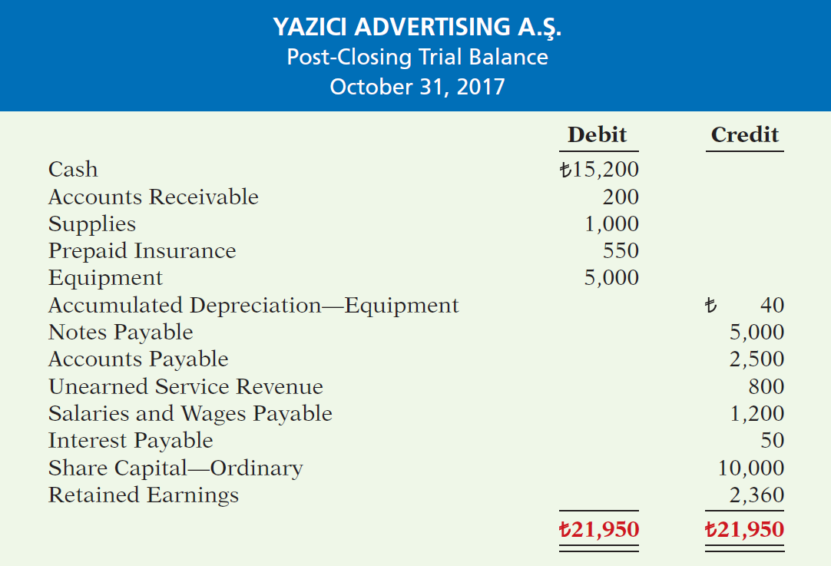
Illustration 4-8
Illustration 4-8
Post-closing trial balance
LO 3

Slide 28
The Accounting Cycle
Learning Objective 4
State the required steps in the accounting cycle.
1. Analyze business transactions
9. Prepare a post-closing trial balance
2. Journalize the transactions
8. Journalize and post closing entries
3. Post to ledger accounts
7. Prepare financial statements
4. Prepare a trial balance
6. Prepare an adjusted trial balance
5. Journalize and post adjusting entries
Illustration 4-11
Steps in the accounting cycle
LO 4

Slide 29
Correcting Entries—An Avoidable Step
Learning Objective 5
Explain the approaches to preparing correcting entries.
Unnecessary if accounting records are
free of errors.
Made whenever an error is discovered.
Must be posted before closing entries.
Instead of preparing a correcting entry, it is possible to reverse the incorrect entry and then prepare the correct entry.
LO 5

Slide 30
Correcting Entries—An Avoidable Step
CASE 1: On May 10, Bai Co. journalized and posted a NT$500 cash collection on account from a customer as a debit to Cash NT$500 and a credit to Service Revenue NT$500. The company discovered the error on May 20, when the customer paid the remaining balance in full.
Incorrect entry
Cash 500
Service Revenue 500
Correct entry
Cash 500
Accounts Receivable 500
Correcting entry
Service Revenue 500
Accounts Receivable 500
LO 5

Slide 31
Correcting Entries—An Avoidable Step
CASE 2: On May 18, Mercato purchased on account equipment costing NT$4,500. The transaction was journalized and posted as a debit to Equipment NT$450 and a credit to Accounts Payable NT$450. The error was discovered on June 3.
Incorrect entry
Equipment 450
Accounts Payable 450
Correct entry
Equipment 4,500
Accounts Payable 4,500
Correcting entry
Equipment 4,050
Accounts Payable 4,050
LO 5

Slide 32
INVESTOR INSIGHT
Why Accuracy Matters
How Can Accounting Aid African Growth?
The accuracy of a company’s financial records is very important to investors, but other issues are also of concern. Recently, the Nigerian Stock Exchange adopted a corporate-governance system to assess the 190 companies that are listed on the exchange. The rating system requires the companies to answer questions about business ethics, audit procedures, internal controls, disclosure practices, and other matters. Africa’s economy is growing rapidly, so it offers many opportunities to investors and companies. But the accounting practices of many African companies lag behind those of companies in other parts of the world. In order to attract more outside investment and therefore lower the cost of financing projects, many African companies have adopted IFRS. One financial advisor said that while trying to help one African company, she found accounts that were commingled and assets that had not been recorded because they had been purchased with cash. She emphasized, however, that “just because they don’t have the best accounting records doesn’t mean they don’t have a good business.”
Source: Kimberly S. Johnson, “Africa Makes Strides in Corporate Accounting, Governance,” Wall Street Journal Online (November 17, 2014).
LO 5

Slide 33
>
DO IT!
Sanchez Company discovered the following errors made in January 2017 .
A payment of Salaries and Wages Expense of $600 was debited to Supplies and credited to Cash, both for $600.
A collection of $3,000 from a client on account was debited to Cash $200 and credited to Service Revenue $200.
The purchase of supplies on account for $860 was debited to Supplies $680 and credited to Accounts Payable $680.
Correct the errors without reversing the incorrect entry.
LO 5

Slide 34
>
DO IT!
Sanchez Company discovered the following errors made in January 2017 .
A payment of Salaries and Wages Expense of $600 was debited to Supplies and credited to Cash, both for $600.
Correct the error without reversing the incorrect entry.
Salaries and Wages Expense 600
Supplies 600
LO 5

Slide 35
>
DO IT!
Sanchez Company discovered the following errors made in January 2017 .
A collection of $3,000 from a client on account was debited to Cash $200 and credited to Service Revenue $200.
Correct the error without reversing the incorrect entry.
Service Revenue 200
Cash 2,800
Accounts Receivable 3,000
LO 5

Slide 36
>
DO IT!
Sanchez Company discovered the following errors made in January 2017 .
The purchase of supplies on account for $860 was debited to Supplies $680 and credited to Accounts Payable $680.
Correct the error without reversing the incorrect entry.
Supplies ($860 - $680) 180
Accounts Payable 180
LO 5

Slide 37
Statement of Financial Position
Learning Objective 6
Identify the sections of a classified statement of financial position.
Presents a snapshot at a point in time.
To improve understanding, companies group similar assets and similar liabilities together.
Standard Classifications
Assets Equity and Liabilities
Intangible assets Equity
Property, plant, and equipment Non-current liabilities
Long-term investments Current liabilities
Current assets
Illustration 4-16
Standard statement of financial position classifications
LO 6

Slide 38
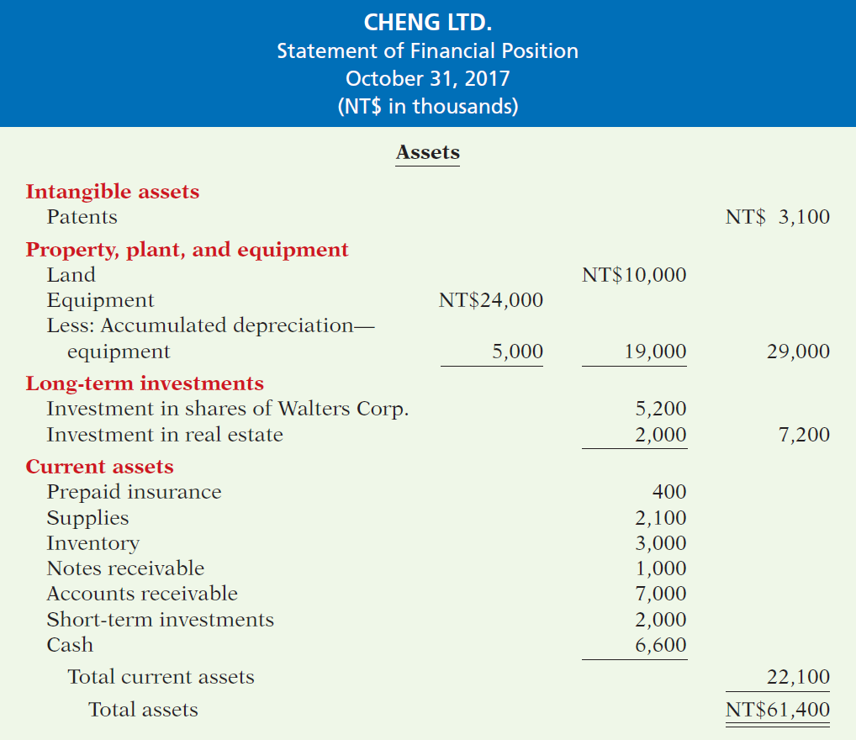
Illustration 4-17
Classified statement of financial position
LO 6

Slide 39
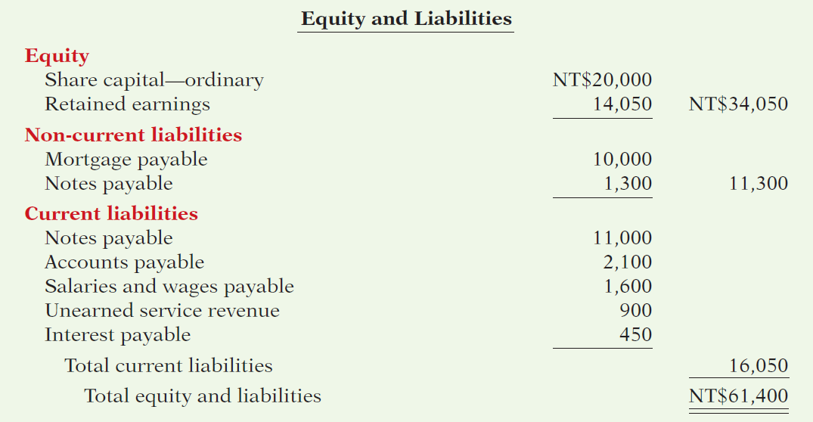
Illustration 4-17
Classified statement of financial position
LO 6

Slide 40
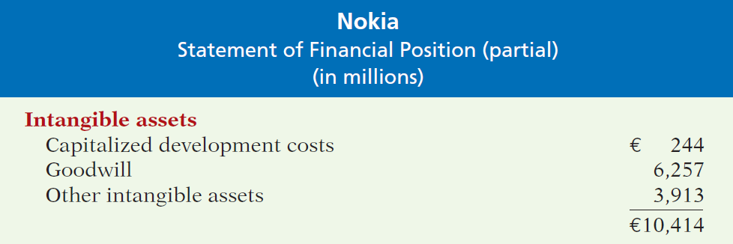
Intangible Assets
Assets that do not have physical substance.
Illustration 4-18
Intangible assets section
LO 6

Slide 41
Property, Plant, and Equipment
Long useful lives.
Currently used in operations.
Depreciation - allocating the cost of assets to a number of years.
Accumulated depreciation - total amount of depreciation expensed thus far in the asset’s life.
LO 6

Slide 42
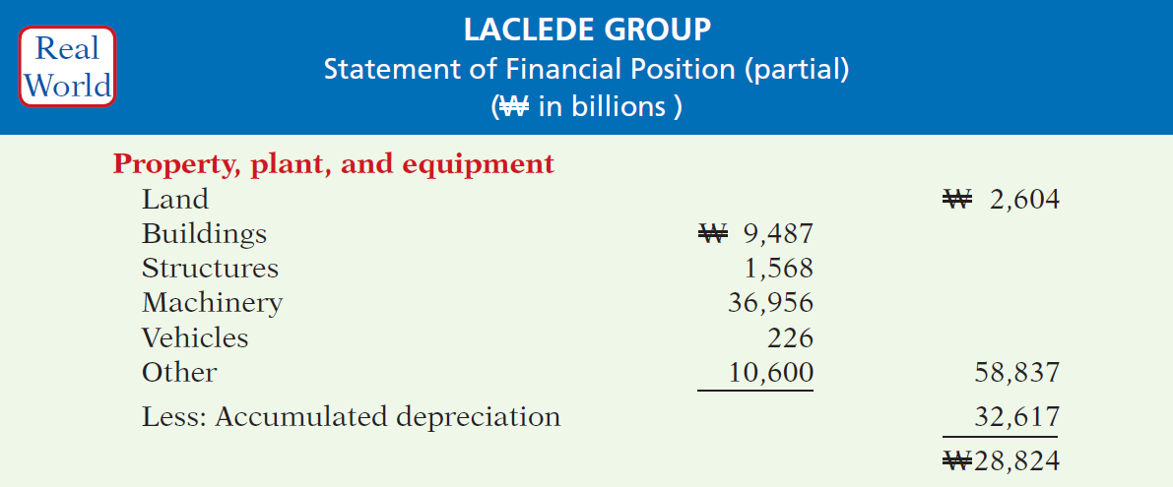
Property, Plant, and Equipment
Illustration 4-19
Property, plant, and equipment section
LO 6

Slide 43
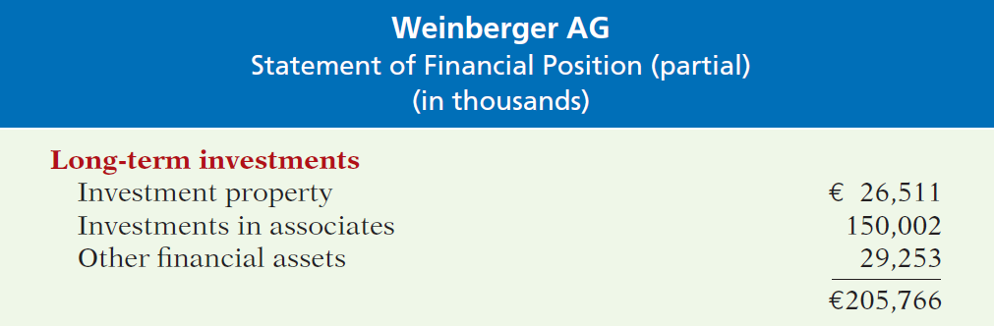
Long-Term Investments
Investments in ordinary shares and bonds of other companies.
Investments in non-current assets such as land or buildings that a company is not using in its operating activities.
Illustration 4-20
Long-term investments section
LO 6

Slide 44
Current Assets
Assets that a company expects to convert to cash or use up within one year or the operating cycle, whichever is longer.
Operating cycle is the average time it takes from the purchase of inventory to the collection of cash from customers.
LO 6

Slide 45
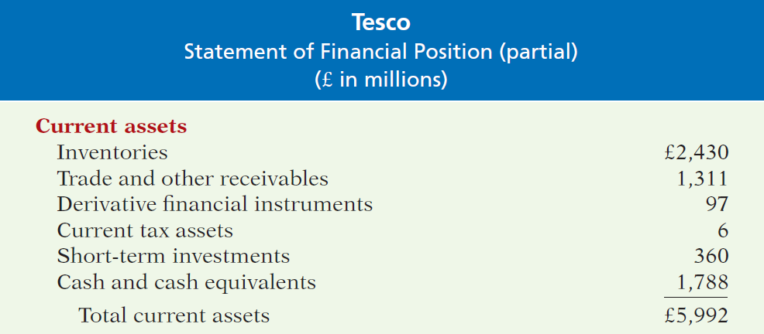
Current Assets
Illustration 4-21
Current assets section
Accounts usually listed in the reverse order they expect to convert them into cash.
LO 6

Slide 46
People, Planet, and Profit Insight
Creating Value
Appendix B at the end of this textbook contains the financial statements of Nestlé SA (CHE). Nestlé, like many other companies today, reports its achievements with regard to other, nonfinancial goals. In Nestlé’s case, it calls these goals “Creating Shared Value.” Nestlé has set objectives to help society in areas most directly related to its particular expertise: nutrition, water and environmental sustainability, and rural development. The company evaluates its progress in each area using objective measures. Examples of measures used are provided below.
Nutrition: Products meeting or exceeding Nutritional Foundation profiling criteria (as percentage of total sales) and products with increase in nutritious ingredients or essential nutrients.
Water and Environmental Sustainability: Quality of water discharged (average mg COD/I) and packaging weight reduction (tonnes).
Rural Development: Farmers trained through capacity building programs and suppliers audited for food safety, quality, and processing.
LO 6

Slide 47
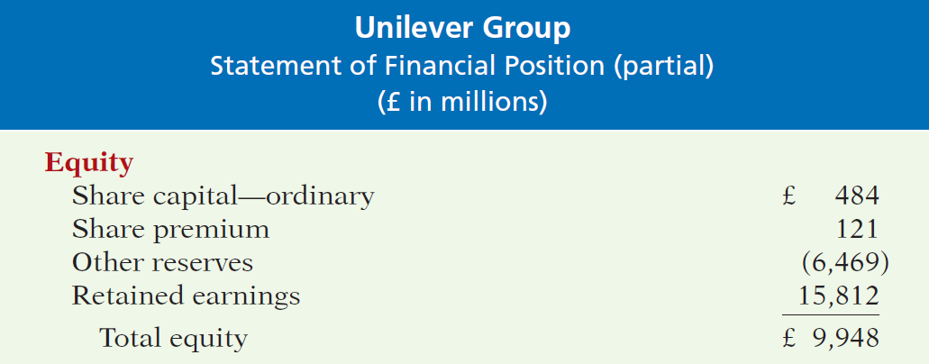
Equity
Proprietorship - one capital account.
Partnership - capital account for each partner.
Corporation – Share Capital and Retained Earnings.
Illustration 4-22
Equity section
LO 6

Slide 48
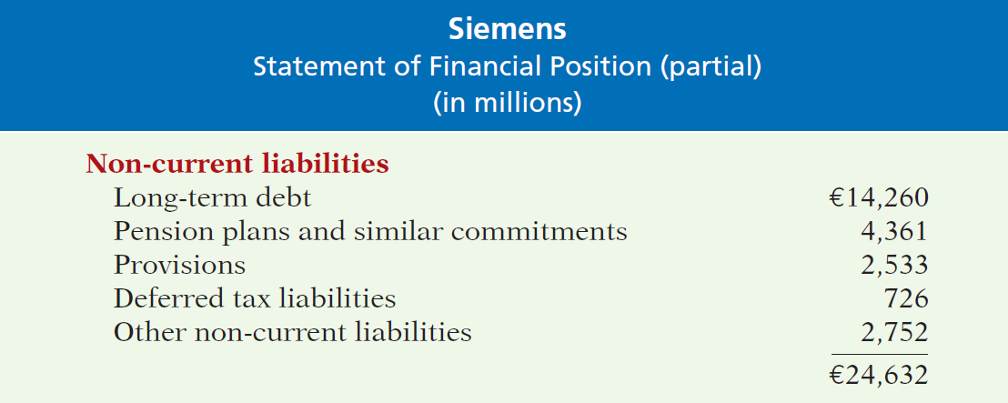
Non-Current Liabilities
Obligations a company expects to pay after one year.
Illustration 4-23
Non-current liabilities section
LO 6

Slide 49
Current Liabilities
Obligations company is to pay within the coming year or its operating cycle, whichever is longer.
Usually list notes payable first, followed by accounts payable. Other items follow in order of magnitude.
Liquidity - ability to pay obligations expected to be due within the next year.
LO 6

Slide 50
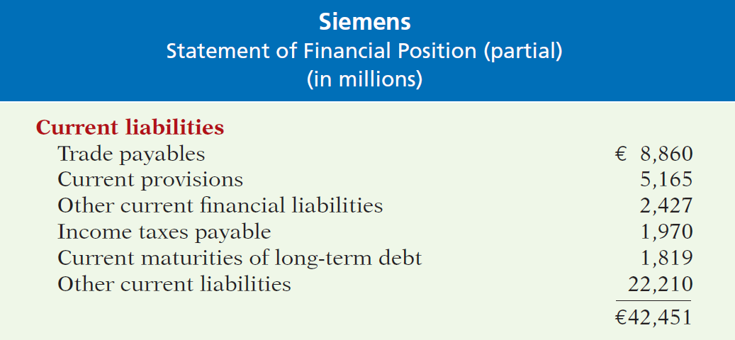
Current Liabilities
Illustration 4-24
Current liabilities section
LO 6

Slide 51
ACCOUNTING ACROSS THE ORGANIZATION
Can a Company Be Too Liquid?
There actually is a point where a company can be too liquid—that is, it can have too much working capital (current assets less current liabilities). While it is important to be liquid enough to be able to pay short-term bills as they come due, a company does not want to tie up its cash in extra inventory or receivables that are not earning the company money. By one estimate, 1,000 large companies had cumulative excess working capital of $764 billion. Based on this figure, these companies could have reduced debt by 36% or increased net income by 9%. Given that managers throughout a company are interested in improving profitability, it is clear that they should have an eye toward managing working capital. They need to aim for a “Goldilocks solution”—not too much, not too little, but just right.
Source: K. Richardson, “Companies Fall Behind in Cash Management,” Wall Street Journal (June 19, 2007).
LO 6

Slide 52
Statement of Financial Position
Question
The correct order of presentation in a classified statement of financial position for the following current assets is:
accounts receivable, cash, prepaid insurance, inventories.
cash, inventories, accounts receivable, prepaid insurance.
prepaid insurance, inventories, accounts receivable, cash.
inventories, cash, accounts receivable, prepaid insurance.
LO 6

Slide 53
Statement of Financial Position
Question
In a classified statement of financial position, assets are usually classified using the following sequence of categories:
current assets; non-current assets; property, plant, and equipment; intangible assets.
tangible assets; property, plant, and equipment; long-term investments; current assets.
current assets; long-term investments; tangible assets; intangible assets.
intangible assets; property, plant, and equipment; long-term investments; current assets.
LO 6

Slide 54
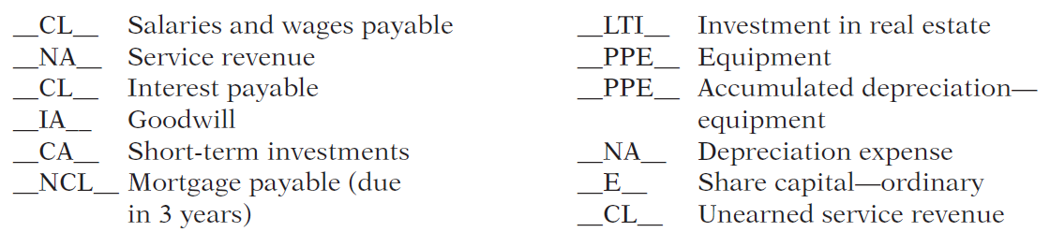
>
DO IT!
The following accounts were taken from the financial statements of Callahan Company.
Match each of the following accounts to its proper statement of financial position classification, shown below. If the item would not appear on a statement of financial position, use “NA.”
Current assets (CA) Current liabilities (CL)
Long-term investments (LTI) Non-current liabilities (NCL)
Property, plant, and equipment (PPE) Equity (E)
Intangible assets (IA)
LO 6

Slide 55
APPENDIX 4A
Reversing Entries
Learning Objective 7
Prepare reversing entries.
It is often helpful to reverse some of the
adjusting entries before recording the regular transactions of the next period.
Companies make a reversing entry at the beginning of the next accounting period.
Each reversing entry is the exact opposite of the adjusting entry made in the previous period.
The use of reversing entries does not change the amounts reported in the financial statements.
LO 7

Slide 56
Reversing Entries Example
Illustration: To illustrate the optional use of reversing entries for accrued expenses, we will use the salaries expense transactions for Yazici Advertising A.S.
October 26 (initial salary entry): Pioneer pays ₺4,000 of salaries and wages earned between October 15 and October 26.
October 31 (adjusting entry): Salaries and wages earned between October 29 and October 31 are ₺1,200. The company will pay these in the November 9 payroll.
November 9 (subsequent salary entry): Salaries and wages paid are ₺4,000. Of this amount, ₺1,200 applied to accrued salaries and wages payable and ₺2,800 was earned between November 1 and November 9.
LO 7

Slide 57
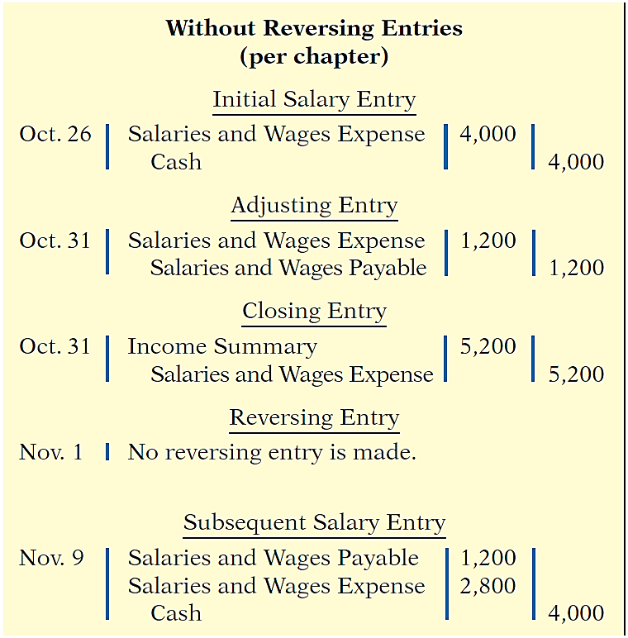
Reversing Entries Example
With Reversing Entries (per appendix)
Initial Salary Entry
Oct. 26 Same entry
Adjusting Entry
Oct. 31 Same entry
Closing Entry
Oct. 31 Same entry
Reversing Entry
Nov. 1
Salaries and Wages Payable 1,200
Salaries and Wages Expense 1,200
Subsequent Salary Entry
Nov. 9
Salaries and Wages Expense 4,000
Cash 4,000
Illustration 4A-1
Comparative entries—not reversing vs. reversing
LO 7

Slide 58
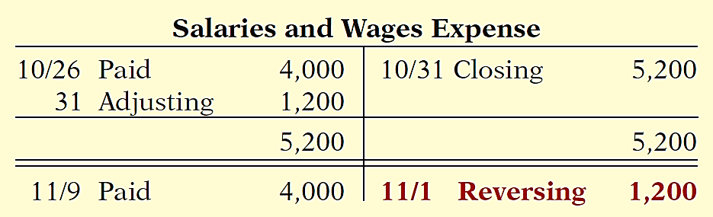
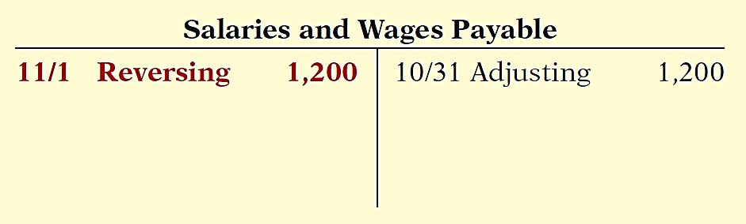
Reversing Entries Example
Illustration 4A-2 Postings with reversing
entries
LO 7

Slide 59
A Look at U.S. GAAP
Learning
Objective 8
Compare the procedures for the closing process under IFRS and U.S. GAAP.
Key Points
Similarities
Both IFRS and GAAP require disclosures about
(1) accounting policies followed, (2) judgments that management has made in the process of applying the entity’s accounting policies, and (3) the key assumptions and estimation uncertainty that could result in a material adjustment to the carrying amounts of assets and liabilities within the next financial year.
Comparative prior-period information must be presented and financial statements must be prepared annually.
LO 8

Slide 60
A Look at U.S. GAAP
Key Points
Differences
IFRS officially uses the term statement of financial position in its literature, while in the United States it is often referred to as the balance sheet.
IFRS requires that specific items be reported on the statement of financial position, whereas no such general standard exists in GAAP. However, under GAAP, public companies must follow U.S. Securities and Exchange Commission (SEC) regulations, which require specific line items as well. In addition, specific GAAP standards mandate certain forms of reporting statement of financial position information. The SEC guidelines are more detailed than IFRS.
While IFRS companies often report non-current assets before current assets in their statements of financial position, this is never seen under GAAP. Also, some IFRS companies report the subtotal “net assets,” which equals total assets minus total liabilities. This practice is also not seen under GAAP.
LO 8

Slide 61
A Look at U.S. GAAP
Key Points
Differences
A key difference in valuation is that under IFRS, companies, under certain conditions, can report property, plant, and equipment at cost or at fair value, whereas under GAAP this practice is not allowed.
GAAP has many differences in terminology from what are shown in your textbook. For example, in the investment category shares are called stock. Also note that Share Capital—Ordinary is referred to as Common Stock. In addition, the format used for statement of financial position presentation is often different between GAAP and IFRS.
LO 8

Slide 62
A Look at U.S. GAAP
Looking to the Future
The IASB and the FASB are working on a project to converge their standards related to financial statement presentation. A key feature of the proposed framework is that each of the statements will be organized in the same format, to separate an entity’s financing activities from its operating and investing activities and, further, to separate financing activities into transactions with owners and creditors. Thus, the same classifications used in the statement of financial position would also be used in the income statement and the statement of cash flows.
LO 8

Slide 63
A Look at U.S. GAAP
A Look at IFRS
IFRS Self-Test Questions
Which of the following statements is false?
Assets equals liabilities plus stockholders’ equity.
Under IFRS, companies sometimes net liabilities against assets to report “net assets.”
The FASB and IASB are working on a joint conceptual framework project.
Under GAAP, the statement of financial position is usually referred to as the statement of assets and equity.
LO 8

Slide 64
A Look at U.S. GAAP
A Look at IFRS
IFRS Self-Test Questions
Current assets under GAAP are listed generally:
by importance.
in the reverse order of their expected conversion to cash.
by order of liquidity.
alphabetically.
LO 8

Slide 65
A Look at U.S. GAAP
A Look at IFRS
IFRS Self-Test Questions
Companies that use GAAP:
may report all their assets on their balance sheets at fair value.
often offset assets against liabilities and show net assets and net liabilities on their balance sheets, rather than the underlying detailed line items.
generally report current assets before non-current assets on their balance sheets.
do not have any guidelines as to what should be reported on their balance sheets.
LO 8

Slide 66
Copyright
“Copyright © 2016 John Wiley & Sons, Inc. All rights reserved. Reproduction or translation of this work beyond that permitted in Section 117 of the 1976 United States Copyright Act without the express written permission of the copyright owner is unlawful. Request for further information should be addressed to the Permissions Department, John Wiley & Sons, Inc. The purchaser may make back-up copies for his/her own use only and not for distribution or resale. The Publisher assumes no responsibility for errors, omissions, or damages, caused by the use of these programs or from the use of the information contained herein.”

